Slide 1

EE Warehouse management
Update FIFO Algorithm

Slide 2

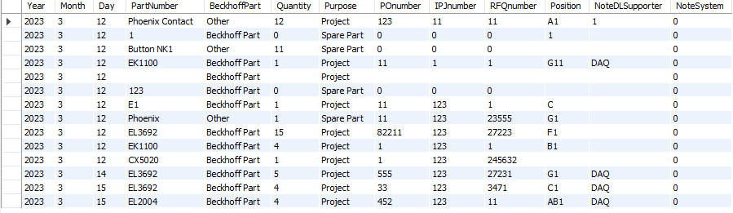
First in will be first out

Slide 3
First in will be first out
1
2
3
15
5
4
Quantity need

Slide 4
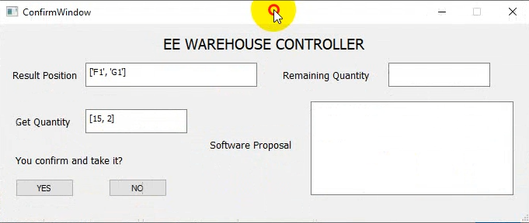
RESULT explanation

